Slide 1
Interaksi Manusia dan Komputer (IMK)
Tim Dosen IMK
KK SIDE
THE USER INTERFACE (UI) DESIGN PROCESS
Step 10 Internasionalization and Accessibility
Step 11-12 Create Meaningful Graphics, Icons, and Images & Choose the Proper Colors

Slide 2
Tujuan
Step 10
Setelah mengikuti materi ini mahasiswa dapat:
Mahasiswa/i dapat mampu menerapkan internasionalisasi dan aksesibilitas dalam desain UI.
Step 11,12
Setelah mengikuti materi ini mahasiswa dapat:
Mahasiswa/I mampu menerapkan Graphics, Icons, Images & Warna yang sesuai dengan kebutuhan

Slide 3
Outline (Step 10)
Pertimbangan Internasionalisasi
Lokalisasi
Aksesibilitas

Slide 4
Outline (Step 11,12)
Icons & Graphics
Penggunaan Multimedia
Pemasalahan Warna
Pemilihan Warna

Slide 5
Pertimbangan Internasionalisasi

Slide 6
Internasionalization
Today the Internet and the market for software are global. They cross endless cultural and language boundaries, each with its own requirements, conventions, customs, and definitions of acceptability.
Comprehension and recall can be enhanced when presented information is culturally appropriate (Spyridakis and Fukuoka, 2002).
To make a product acceptable worldwide, it must be internationalized. A system must also be designed to be usable by an almost unlimited range of people, being accessible to anyone who desires to use it. The design concepts used to achieve these goals are called internationalization and accessibility.

Slide 7
Today’s Topics
International considerations
Localization
Writing text
Accessibility considerations
Types of disabilities
Designing for accessibility
Cultural considerations
Using images and symbols

Slide 8
Lokalisasi

Slide 9
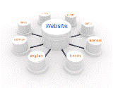
Localization
When to do it:
When the market includes few or no English speakers.
When translation is required by law or by custom.
When the widest possible market is desired.
When not to do it:
When the audience already reads English.
When the cost of retrofitting or rewriting the software is prohibitive.

Slide 10
Cultural Considerations
Hofstede (1980, 1997, 2001) has derived and validated five independent dimensions along which cultures vary:
Power distance is the degree of acceptance of inequality of power and authority
Individualism (vs. collectivism) reflects how well integrated a person is into the larger group.
Masculinity (vs. femininity) is the balance between assertiveness or toughness and supportiveness or caring.
Uncertainty avoidance is the level of discomfort with unstructured and potentially unpredictable conditions.
Long-term orientation (vs. short term) is the trade-off between long-term reward and immediate recognition.

Slide 11
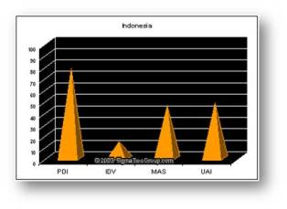
Indonesia
PDI(78)→ a high level of inequality of power and wealth within the society.
UAI(48) → more moderated influence of this Dimension within the Indonesian society. In an effort to minimize or reduce this level of uncertainty, strict rules, laws, policies, and regulations are adopted and implemented.
IDV (14) → the Indonesian society is Collectivist as compared to Individualist.
Notes:
Indonesia has Power Distance (PDI) as its highest ranking Hofstede Dimension at 78. The high Power Distance (PDI) is indicative of a high level of inequality of power and wealth within the society. This condition is not necessarily forced upon the population, but rather accepted by the society as part of their cultural heritage. The average Power Distance for the greater Asian countries is 71.
The second highest Hofstede ranking for Indonesia is Uncertainty Avoidance (UAI) at 48, compared to the greater Asian average of 58 and a world average of 64. This reflects a more moderated influence of this Dimension within the Indonesian society. Generally, a high Uncertainty Avoidance (UAI) indicates the society’s low level of tolerance for uncertainty. In an effort to minimize or reduce this level of uncertainty, strict rules, laws, policies, and regulations are adopted and implemented. The ultimate goal of this population is to control everything in order to eliminate or avoid the unexpected. As a result of this high Uncertainty Avoidance characteristic, the society does not readily accept change and is very risk adverse.
Indonesia has one of the lowest world rankings for Individualism with a 14, compared to the greater Asian rank of 23, and world rank of 43. The score on this Dimension indicates the Indonesian society is Collectivist as compared to Individualist. This is manifest in a close long-term commitment to the member 'group', is that a family, extended family, or extended relationships. Loyalty in a collectivist culture is paramount, and over-rides most other societal rules and regulations. The society fosters strong relationships where everyone takes responsibility for fellow members of their group

Slide 12

Words and Text
Use very simple English
Avoid
Acronyms and abbreviations
Slang or obscure phrasing
Local or computer jargon
A telegraphic/ over friendly writing style
Culturally specific examples.
Adhere to local user language idioms and cultural contexts
Keep the original term for words that cannot be translated
Allow additional screen space for the translation
Position icon captions outside of the graphic
Modify mnemonics for keyboard access
Adhere to local formats for date, time, money, measurements, addresses, and telephone numbers

Slide 13
Images and Symbols
Adhere to local cultural and social norms
Use internationally accepted symbols
Develop generic images
Be particularly careful with
Religious symbols (crosses and stars)
The human body
Women
Hand gestures
Flags
Controversial geographic maps
The cross and check for check boxes
Review proposed graphical images early in the design cycle

Slide 14

Color, Sequence, and Functionality
Adhere to local color connotations and conventions
Provide the proper information sequence
Provide the proper functionality
Remove all references to features not supported

Slide 15
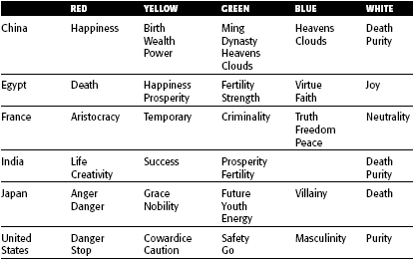
Cultural Color Associations

Slide 16

Requirements Determination and Testing
Establish international requirements at the beginning of product development
Establish a relationship within the target culture
Test the product as if it were new

Slide 17
Aksesibilitas

Slide 18
Accessibility
Accessibility means a system must be usable by an almost unlimited range of people
Design objectives in creating accessibility for users with disabilities are:
Minimize all barriers that make a system difficult, or impossible, to use.
Provide compatibility with installed accessibility utilities.
Types of disabilities:
Visual → reduced visual acuity to total blindness.
Hearing → inability to detect certain sounds to total deafness.
Physical movement → difficulties in, or an inability to, perform certain physical tasks such as moving a mouse, or accurately striking a single keyboard key.
Speech or language → difficult to read and write
Cognitive → memory impairments and perceptual problems.
Seizure disorders → sensitive to visual flash rates, certain rates triggering seizures.

Slide 19

Accessibility Design
Consider accessibility issues during system planning, design, and testing.
Provide compatibility with installed accessibility utilities.
Provide a customizable interface.
Follow standard Windows conventions.
Use standard Windows controls.
Assure online forms can be easily completed.

Slide 20
Visual Disabilities
Ensure compatibility with screen-review utilities and screen-enlargement utilities
Screen components:
Include meaningful screen and window titles.
Provide associated captions or labels for all controls, objects, icons, and graphics.
Include graphical menu choices.
Provide a textual summary for each statistical graphic.
Allow for screen element scalability.
Support system settings for high contrast for all user interface controls and client area content.
When a high contrast setting is established, hide any images drawn behind the text to maintain screen information legibility.
Avoid displaying or hiding information based on the movement of the pointer. Exception: Unless it’s part of the standard interface (example: ToolTips).

Slide 21
Visual Disabilities ..
Keyboard:
Provide a complete keyboard interface.
Provide a logical order of screen navigation.
Color:
Use color as an enhancing design characteristic.
If used, considers
color combinations
lightness contrast between foreground and background color
lightness contrast between colors in the color spectrum (blues and reds)
Avoid combining dark colors from the middle of the spectrum with light colors from either end of the spectrum
Do not define specific colors
Use tools to verify what colors will look like when seen by color-deficient people

Slide 22
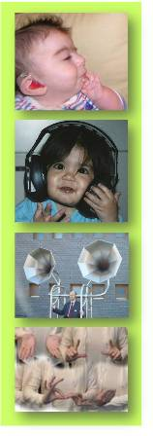
Hearing Disabilities
Provide captions or transcripts of important audio content.
Provide an option to display a visual cue for all audio alerts.
Provide an option to adjust the volume.
Use audio as an enhancing design characteristic.
Provide a spell-check or grammar-check utility.

Slide 23
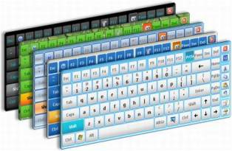
Physical Movement Disabilities
Provide voice-input systems
Provide a complete and simple keyboard interface
Provide a simple mouse interface
Provide on-screen keyboards
Provide keyboard filters

Slide 24

Cognitive Disabilities
Permit modification and simplification of the interface.
Limit the use of time-based interfaces.
Do not briefly display critical feedback or messages and then automatically remove them.
Provide an option to permit the user to adjust the length of the time-out.

Slide 25
Seizure Disorders
Use elements that do not blink or flicker at rates
between frequency ranges of 2 Hz and 55 Hz.
Minimize the area of the screen that is flashing.
Avoid flashing that has a high level of contrast
between states.
Provide an option to enable users to slow down or
disable screen flashing.

Slide 26
Web Page Accessibility Design
WWW Consortium Accessibility Guidelines:
Provide equivalent alternatives to auditory or visual content
Don’t rely on color alone. Image should be understandable
Use markup and style sheets and do so properly
Clarify natural language usage
Create tables that transform gracefully
Pages featuring new technologies transform gracefully
Ensure user control of time-sensitive content changes
Ensure direct accessibility of principles of embedded interfaces
Design for device-independence
Use interim solutions
Use W3C technologies and follow accessibility guidelines
Provide context and orientation information
Provide clear navigation mechanisms
Ensure that documents are clear and simple

Slide 27
Usability for Lower-Literacy People
Prioritize information
Avoid moving or changing text
Streamline the page design
Simplify navigation
Optimize search

Slide 28

Usability for Senior Citizens
Provide large targets to make selection easier
To reduce the number of selections or clicks,
Do not require double-clicks or pull-down menus
Do not have a deep page hierarchy.
Concentrate important information at the top of pages.
Avoid the need to scroll to find information.
Put most links in a bulleted, not tightly clustered, list.
Provide differentiation between visited and non-visited links.
Use few colors, and avoid using blue and green tones.
For text to be read or scanned, use
12 to 14 point sans serif font (Helvetica, Arial).
Black text on a white background, left justification.
Increased spacing (leading) between lines.
Sentence style mixed-case letters rather than all capital letters.
Appropriate large headings in a 14 to 16 point sans serif font.

Slide 29
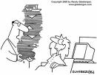
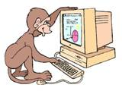
Documentation
Provide documentation on all accessible features
Provide documentation in alternate formats
Provide online documentation for people who have difficulty reading or handling printed material
Testing
Test all aspects of accessibility as part of the normal system testing process

Slide 30
Icons & Graphics

Slide 31
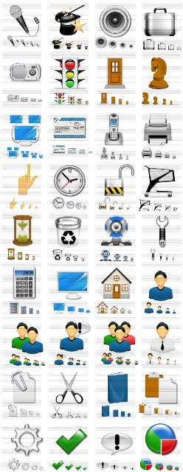
Icons
Icons are pictorial images most often used to represent objects and actions with which users can interact with or that they can manipulate.
Icons may stand alone on a desktop or in a window, or be grouped together in a toolbar.
A secondary use of an icon is to reinforce important information, such as a warning icon in a dialog message box.
Provide icons that are familiar, clear and legible, simple, consistent, direct, efficient, and discriminable.
Also consider the
Context in which the icon is used.
Expectancies of users.
Complexity of task.

Slide 32
Kinds of Icons
Marcus (1984):
Icon. Something that looks like what it means.
Index. A sign that was caused by the thing to which it refers.
Symbol. A sign that may be completely arbitrary in appearance.
Rogers (1989):
Resemblance. An image that looks like what it means.
Ex. A book → a dictionary
Symbolic. An abstract image representing something.
Ex. A cracked glass → something fragile
Exemplar. An image illustrating an example or characteristic of something. Ex. A freeway exit picturing knife and fork → restaurant
Arbitrary. An image completely arbitrary in appearance whose meaning must be learned. Ex. Menu and sizing icons on screens
Analogy. An image physically or semantically associated with something. Ex. a wheelbarrow full of bricks → move command

Slide 33
Some common icons. What do they stand for?
Hot Cold Fast Slow
Engine Oil Ammeter/ Generator Straight Turn
Automatic Variable Regulation Plus/ Positive Minus/ Neg

Slide 34
Max Number of Codes for Effective Human Differentiation
Encoding Method | Recom. Max. | Comments
Alphanumeric | Unlimited | High versatile. Meaning usually self-evident. Location time may be longer than for graphic coding.
Geometric Shapes | 10-20 | High mnemonic value. Very effective if shape relates to object or operation being represented
Size | 3-5 | Fair. Considerable space required. Location time longer than for colors and shapes.
Line Length | 3-4 | Will clutter the display if many are used.
Line Width | 2-3 | Good.
Line Style | 5-9 | Good.
Line Angle | 8-11 | Good in special cases (Such as wind direction)
Solid and Broken Lines | 3-4 | Good
Number of Dots or Marks | 5 | Minimize number for quick assimilation.

Slide 35
Max Number of Codes for Effective Human Differentiation ..
Encoding Method | Recom. Max. | Comments
Brightness | 2-3 | Creates problems on screens with poor contrast.
Flashing/ blinking | 2-3 | Confusing for general encoding but the best way to attract attention. Interacts poorly with other codes. Annoying if overused. Limit to small fields.
Underlining | No data | Useful but can reduce text legibility.
Reverse Polarity | No data | Effective for making data stand out. Flicker easily perceived in large areas.
Orientation (location on display surface) | 4-8 | -
Color | 6-8 | Attractive and efficient. Short location time. Excessive use confusing. Poor for the color blind.
Combinations of codes | Unlimited | Can reinforce coding but complex combinations can be confusing.

Slide 36
A Successful Icon
Looks different from all other icons.
Is obvious what it does or represents.
Is recognizable when no larger than 16 pixels square.
Looks as good in black and white as in color.
Choosing Icons Images:
Use existing icons when available.
Use images for nouns, not verbs.
Use traditional images.
Consider user cultural and social norms.

Slide 37
Concrete and familiar shapes
Visually & conceptually distinct shapes

Slide 38
Examples
Borders degrading
icon distinctiveness
Communication relationships
in icons
Avoid excessive detail
in icon design

Slide 39
Penggunaan Multimedia

Slide 40
Multimedia
The graphical flexibility of the Web permits inclusion of other media on a screen, including images, photographs, video, diagrams, drawings, and spoken audio.
On the one hand, the various media can be powerful communication and attention-getting techniques.
On the other hand, effective use of multimedia in design has been hindered by a lack of knowledge concerning how the various media may best be used, and a scarcity of applied design guidelines.
The objective is good interaction design, not “sparkle.”

Slide 41
Graphics
Use graphics to
Supplement the textual content, not as a substitute for it.
Convey information that can’t be effectively accomplished using text.
Enhance navigation through
Presenting a site overview.
Identifying site pages.
Identifying content areas.
Limit the use of graphics that take a long time to load.
Coordinate the graphics with all other page elements.
Graphics should not look like gratuitous decorations or banner ads.
Types of graphics (by purpose):
Navigational. To identify links that may be followed
Representational. To illustrate items mentioned in text
Organizational. To relate items mentioned in text
Explanative. To show how things or processes work
Decorative. To provide visual appeal and emphasis

Slide 42
Graphics
Images: should convey their intended messages
Image maps: to provide navigation links to other content
Photographs/ Pictures: used when every aspect of the image is relevant
Video: to show things moving/ changing over time
Diagrams: to show the structure/ relationship of objects
Drawings: when selected parts need to be emphasized/ represented
Animation: to explain ideas involving a change in time/ position
Audition: as a supplement to text and graphics

Slide 43
Combining Mediums
Use sensory combinations that work best together
Closely integrate screen text with graphics
Both the visual and auditory information should be totally relevant to the task being performed
Visual and auditory textual narrative should be presented simultaneously, or the visuals should precede the narrative by no more than 7 seconds
To control attention, reveal information systematically
Limit elements revealed to one item at a time and use sequential revelations for related elements.
Consider downloading times when choosing a media
Thoroughly test all graphics for
Legibility
Comprehensibility
Acceptance

Slide 44
Learning Improvements for Various Media

Slide 45
Permasalahan Warna

Slide 46
Color
Color adds dimension, or realism, to screen usability.
Color draws attention because it attracts a person’s eye.
If used properly, it can emphasize the logical organization of information, facilitate the discrimination of screen components, accentuate differences among elements, and make displays more interesting and attractive.
If used improperly, color can be distracting and possibly visually fatiguing, impairing the system’s usability.

Slide 47
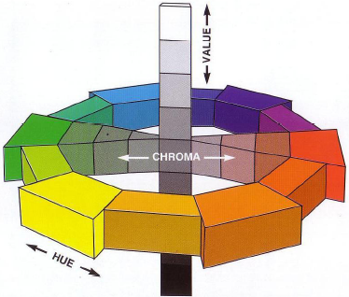
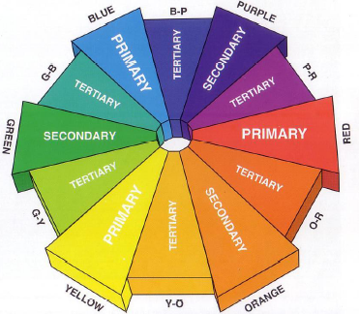
Color Dimensions

Slide 48
Color Uses
Use color to assist informatting a screen
Relating or tying elements into groupings
Breaking apart separate groupings of information
Associating information that is widely separated on the screen
Highlighting or calling attention to important information by setting it off from the other information
Use color as a visual code to identify
Screen components
The logical structure of ideas, processes, or sequences
Sources of information
Status of information
Use color to
Realistically portray natural objects
Increase screen appeal

Slide 49
Possible Problems with Color
High Attention-Getting Capacity
Interference with Use of Other Screens
Varying Sensitivity of the Eye to Different Colors
Color-Viewing Deficiencies
Color Connotations
Cross-Disciplinary and Cross-Cultural Differences

Slide 50
Common Color Connotations
COLOR | POSITIVE | NEGATIVE
Red | Active, Attractive, Dominating, Exciting, Invigorating, Powerful, Strong | Aggressive, Alarming, Energetic
Blue | Abstinent, Controlled, Deep, Dreamy, Faithful, Harmonious, Intellectual, Mysterious, Pornography, Rational, Sensible, Tenderness | Aggressive, Cold, Introverted, Melancholic
Blue-green or turquoise | Refreshing | Aloof, Cold, Self-willed, Sterile, Unemotional
Green | Calm, Close to nature, Conciliatory, Gentle, Harmonious, Optimistic, Refreshing, Strong willed | Envious, Inexperienced, Jealous
Yellow | Cheerful, Colorful, Extroverted, Full of fun, Light, Lively, Youthful | Cowardly, Exaggerated, Superficial, Vain
Orange | Alive, Communicative, Direct, Exciting, Joyful, Warm | Cheap, Intimate, Possessive, Vigorous
Purple | Luxurious, Royal, Serious | Sad
Derived from Gotz (1998) and Stone et al. (2005)

Slide 51
Color – the Research Shows
Color has been shown
to improve performance (Kopala, 1981; Nagy and Sanchez, 1992; Sidorsky, 1982),
to improve visual search time (Christ, 1975; Carter, 1982),
to be useful for organizing information (Engel, 1980), to aid memory (Marcus, 1986b),
to demarcate a portion of a screen (as opposed to lines or type font, Wopking et al., 1985)
Color:
Does not improve performance (Tullis, 1981),
Does not affect on reading text (Legge and Rubin, 1986),
May impair performance (Christ and T, 1973; Christ, 1975),
Is less important than display spacing (Haubner and B, 1983).
For simple displays, color may have no dramatic impact. As display complexity increases, however, so does the value of color. To be effective, color must be properly used.

Slide 52
Effective Foreground / Background Combinations

Slide 53
Pemilihan Warna

Slide 54
Choosing Colors for Web Pages
Color must always have a meaningful purpose
Use the browser 216-color palette
Presentation:
Minimize the number of presented colors
Always consider color in context
Use similar or the same color schemes throughout
For foregrounds: Use black or strong colors for text and headings
For backgrounds: Use weaker contrasting colors such as off-white or light gray
Use a uniform color in large areas
The smaller the element, the more contrast is required between it and its background
Larger images should use
Flat, Web-safe colors
Fewer colors than small images
Select colors to be easily reproduced in black and white
Use default colors for links
Do not display non-link text in link colors
Test all colors

Slide 55
Uses of Color to Avoid
Relying exclusively on color
Too many colors at one time
Highly saturated, spectrally extreme colors together:
Red and blue, yellow and purple
Low-brightness colors for extended viewing or older viewers
Colors in small areas, or for fine details.
Colors lacking contrast:
Ex. yellow and white; black and brown; reds, blues, brown
Fully saturated colors for text or other frequently-read screen components
Pure blue for text, thin lines, and small shapes.
Non-opponent colors.
Red and green in the periphery of large-scale displays.
Adjacent colors that only differ in the amount of blue.
Single-color distinctions for color-deficient users.
Using colors in unexpected ways.
Using color to improve legibility of densely packed text.

